Slide 1
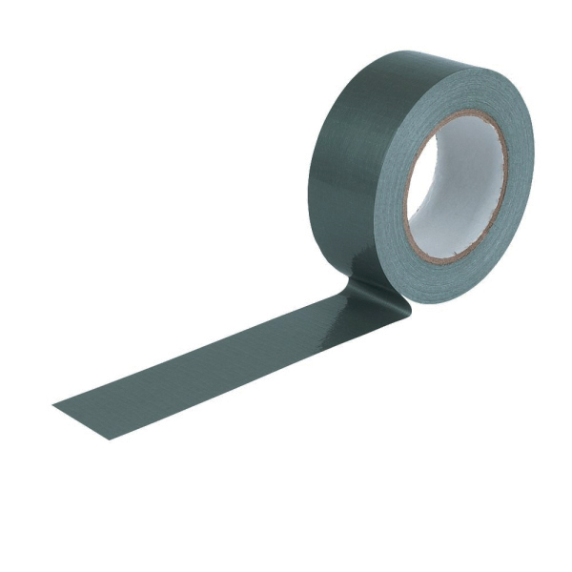
Fixmart Data Sheet V01
^{Product Model}
^{Black Cloth Duct Tape}
Description : Prosolve Gaffa is a Polycloth adhesive tape, Take fibre as backing and coating with synthetic rubber.
Adhesive : Coated with Synthetic Rubber. Thread count n : 30mesh(20*10) Tolerance : +_1mesh
Carrier : Woven polyester and cotton-coated, blended with LDPE
Application
Technical data
supplied by the
manufacturer
Temperature: between 0°C and + 35°C. Surface must be clean and free from dust and grease. Avoid touching the tapes exposed adhesive surface in order to keep full adhesive performance. Pressure sensitive adhesive must be applied with a maximum of pressure in order to achieve maximum pressure level. The indicated level of performance will be reached after a bonding period of 24 HRS at 23 °C.
Storage and shelf life
Applications and uses
Sealing and insulating applications
Hole closure, repairing and masking
Interior and exterior use, General purpose
Packaging, holding and bundling
Technical Details
Total Thickness .. .. 0.17MM+-5%
Adhesive to steel .. . >45 OZ/IN
Tensile Strength .. .. > 28N/10MM
Rolling ball tack .. >10 (Ball no.)
Holding power > 1hours
Service temperature range -15°C -> + 60°C
Size 48mm x 50m
Clean and dry in a well ventilated area, preferably at a temperature between 10°C and 30°C. Stored under these conditions shelf life will be a minimum of 12 months.
Important
The above information is given in good faith, but the user should assure himself that the performance of the product is sufficient for his application. The quoted values are average and should not be taken as maximum or minimum values for specific purposes. Blue Diamond STL cannot be held responsible for product failure unless full testing has been carried out. The client has to decide on the tapes suitability for their own applications.
Remark: This technical data sheet replaces all previous versions. The technical data contained herein is given in good faith and we cannot be held liable for any errors, inaccuracies, omissions or editorial failings. The information detailed in this technical data sheet is given by way of indication and is not exhaustive, users should contact either the seller or the manufacturer of the product for additional technical information concerning its use, if they think the information in their possession needs to be clarified in any way.
^{Solutions,} Service and Supplies to the Trade Springhead Enterprise Park, Springhead Road, Northfleet, Kent DA11 8HJ T 01322 274226 F 01322 278178 E sales@fixmart.co.uk www.fixmart.co.uk

